Slide 1

Telecom Customer Churn Prediction
Submitted By:
Saurabh Mishra
Pawan Jha
Sanket Jadhav
Prakhar Tiwari
Pankaj Mishra
Guided By:
Mr. Parth Pandey

Slide 2

Outline
Introduction
Problem Statement
System Architecture
Data Pre-Processing
Methodology
Machine Learning Algorithms
Data Visualization & Representation
Conclusion
Future Scope
References
2

Slide 3
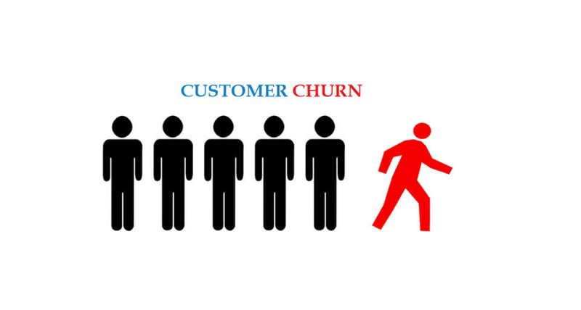
Introduction :
Churn is the process of customers switching from one firm to another in given time. Retaining the existing customers is more profitable than fetching the new customers.
The Companies concentrate to the extant customers to avert churn. A churn prediction model is needed to predict the churners.

Slide 4
Introduction
The fast growth of marketplace in every business is giving rise to increased subscriber base. Accordingly, companies have recognized the significance of retaining the customers who is on hand.
It has become necessary for service-providers to reduce the churn rate of customers since the inattention might negatively influence profitability of the company.
Churn prediction contributes to identify those users who are likely to switch a company over another. The dataset used for customer churn is of telecom industry. It is collected from www.github.com that contains customer and service information for telecom industry.
4

Slide 5
Problem Statement
Using the data provided, this project aims to analyze the data to determine what variables are correlated with customer churn .
We examines customer data from Customer Data Sets with the aim of building and comparing several customer churn prediction models.
To find out the Machine Learning Algorithm model for Predicting Customer Churn to give maximum accuracy.
5

Slide 6
System Architecture
Raw data from Github
Machine Learning (Classification Models)
Data Cleaning and preprocessing & feature Engineering
Model Training and Testing
Deploy and Run Model Using Streamlit
Dumb Data into Local System
Data Visualisation using Tableau
Fig: System Architecture of Telecom Customer Churn Data
6

Slide 7
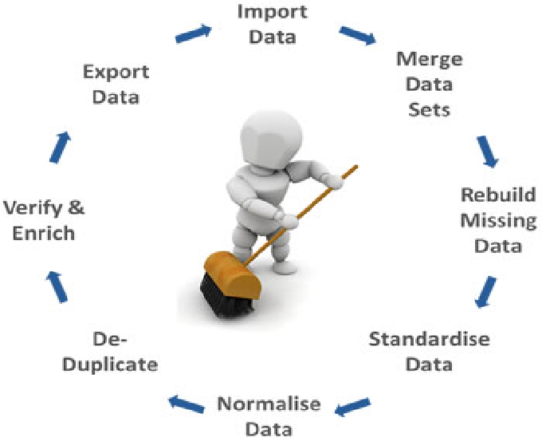
Data Pre-Processing :
Missing Values
Missing Values in the Total Charges columns are replaced with “mean” of that column.
7

Slide 8
Methodology :
Data Used :
Telecom Customer Churn Dataset
Data Filtering :
Cleaned & transformed the data in the format we can access it
Store the Data :
We Store data into Local System
Machine Learning Models Used :
Random Forest Classifier, ADABoost,XGBoost,Decision Tree Classifier.
Visualizing the Data :
Visualised the data using Tableau
Deployment :
Deployment using Streamlit
Fig: Process of Analyzing And Predicting Telecom Customer Churn
8

Slide 9
Machine Learning Algorithms
1. Logistic Regression:
Logistic regression is a classification algorithm used to assign observations to a discrete set of classes. Some of the examples of classification problems are Email spam or not spam, Online transactions Fraud or not Fraud, Tumor Malignant or Benign. And we use this for data surety.
2. Decision Tree Classification:
Decision tree classification is a popular machine learning technique used to classify data into multiple classes or categories. The algorithm builds a tree-like model by recursively splitting the dataset based on the values of different features, using a splitting criterion that maximizes the separation between classes. Each internal node of the tree represents a test of a particular feature, and each branch represents the possible outcomes of that test.
The tree is trained using a set of labeled examples, and the resulting model can be used to classify new instances by traversing the tree and following the path from the root node to a leaf node corresponding to the predicted class. The accuracy of the model can be evaluated using metrics such as accuracy, precision, recall, and F1 score
3. Random Forest Classifier :
Random Forest Classifier is a popular machine learning algorithm that is used for classification tasks. It is an ensemble method that combines multiple decision trees to make predictions. Each tree in the random forest is trained on a subset of the training data and a subset of the features, and the final prediction is made by aggregating the predictions of all the trees.
The algorithm works by first creating multiple decision trees using different subsets of the training data and features. The trees are constructed using a random selection of features at each node, which helps to reduce overfitting and increase diversity. During the prediction phase, each tree predicts the class label of a given input data point, and the final prediction is made by taking a majority vote across all the trees.
.
9

Slide 10
4. AdaBoost:
AdaBoost, short for Adaptive Boosting, is a machine learning algorithm that is used for classification tasks. It is an ensemble method that combines multiple weak learners to create a strong classifier.
The algorithm works by iteratively training a sequence of weak classifiers, each of which is trained on a different subset of the training data. During each iteration, the algorithm assigns higher weights to the training examples that were misclassified by the previous weak classifiers, so that the subsequent weak classifiers are trained to focus more on these difficult examples.
5. XGBoost:
XGBoost (eXtreme Gradient Boosting) is an optimized implementation of the gradient boosting algorithm, which is used for regression and classification tasks. It is a powerful machine learning algorithm that is known for its high accuracy and speed.
XGBoost works by iteratively training a sequence of weak decision tree models, each of which is trained to minimize the gradient of a given loss function. During each iteration, the algorithm uses the gradient information to adjust the weights of the training examples, so that the subsequent weak learners are trained to focus more on the difficult examples.

Slide 11
6. SMOTETomek:
SMOTETomek is a combination of SMOTE and Tomek links, which is a technique for under-sampling. SMOTETomek first applies SMOTE to the minority class to create synthetic examples, and then uses Tomek links to remove examples that are close to the decision boundary but are misclassified. This can result in a better separation of the classes.
These techniques can be implemented using libraries such as imbalanced-learn and scikit-learn in Python. The choice of technique depends on the specifics of the dataset and the machine learning problem being addressed.

Slide 12
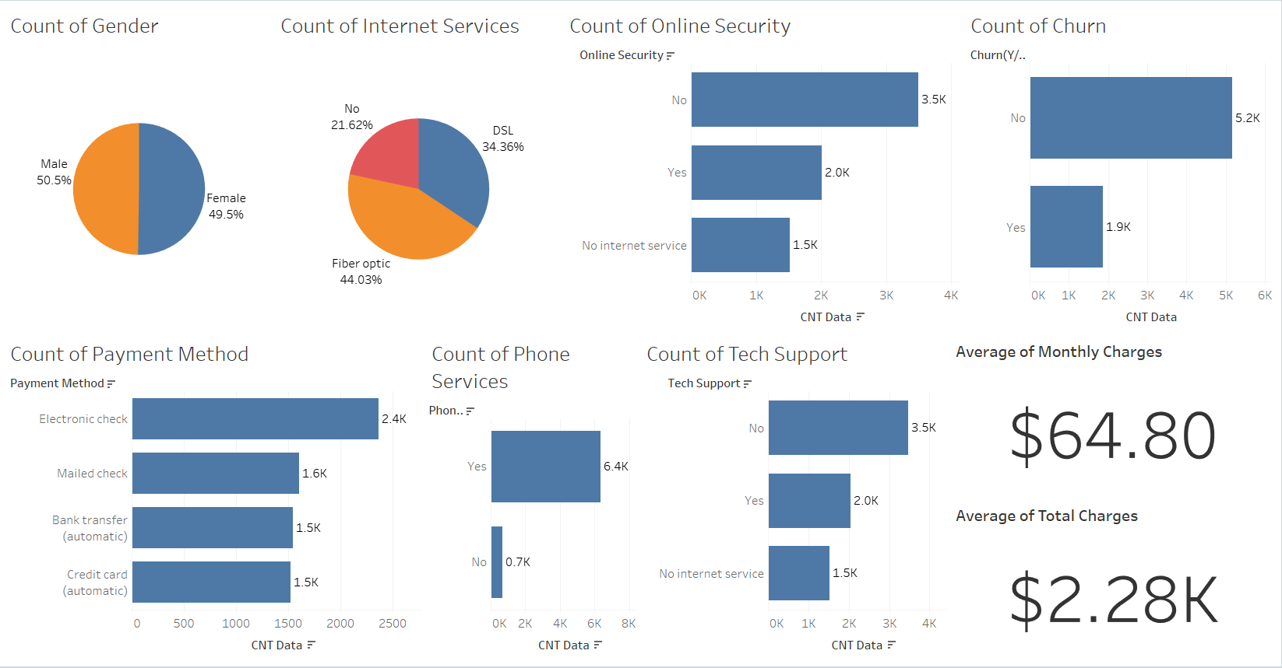
Data Visualization & Representation
Fig.: Telecom Customer Churn Prediction Dashboard

Slide 13
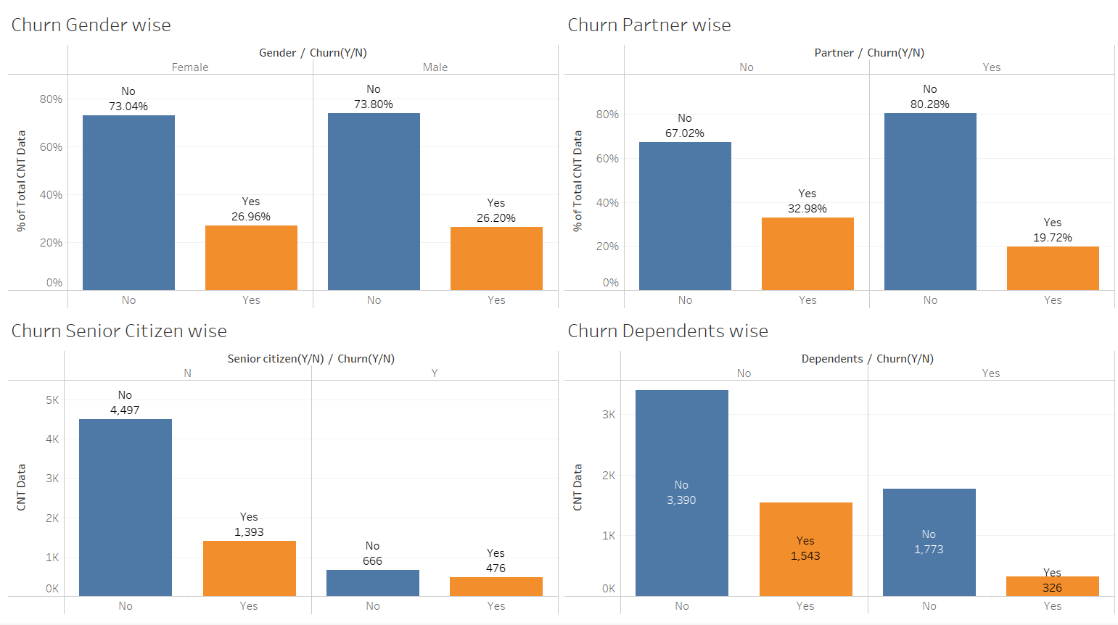
Fig.: Customer Category (Partner, Gender, Senior Citizen, Dependents) Churn Percentage

Slide 14
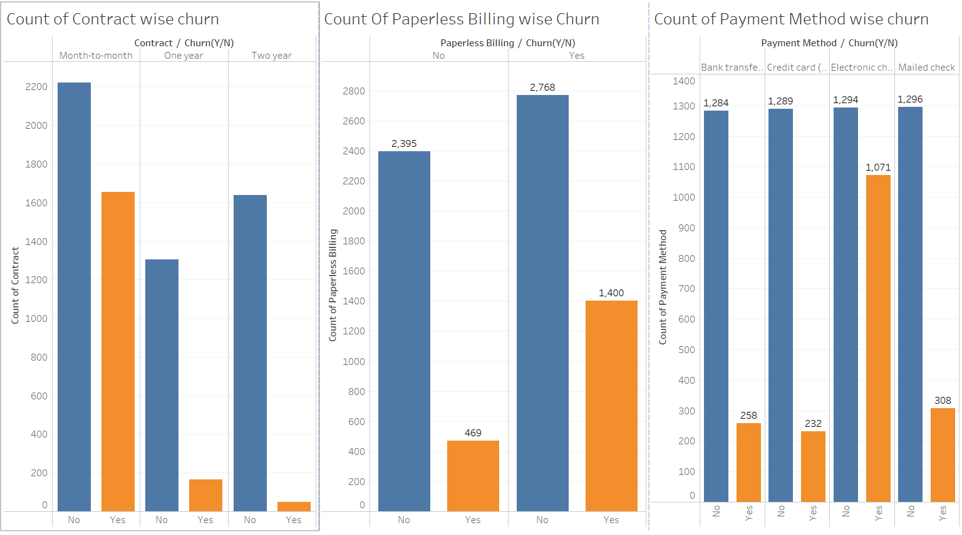
Fig.: Customer Account Information Churn Analysis

Slide 15
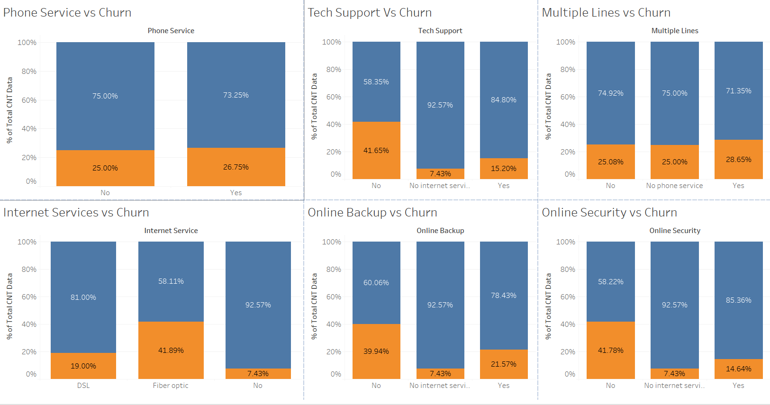
Fig.: Service Information Churn Analysis

Slide 16
Conclusion :
Telecom customer churn is a central issue for telecom companies, since it decreases profits Furthermore, preventing customer churn is crucial As the global telecom industry is becoming more dissolving and companies are increasingly struggling to retain customers .Currently, most companies invest heavily in marketing to attract new customers. However, keeping existing customers is cheaper than acquiring new customers. Thus, it is becoming more critical and a significant concern for telecommunication companies to prevent customer churn.
We used various classification models to predict telecom churn using customer churn data of telecom industry.
Moreover, the results of this project will give us the ability to predict customer behavior and loss accurately and to optimize their strategies to improve customer retention rates.
Meanwhile, the findings will help companies reduce costs and optimize their budgets. Furthermore, for telecom companies, it will be possible to improve customer targeting through the results of this project and to increase the profits of telecom companies.
16

Slide 17
Future Scope :
On the given data and best machine learning model we can build a GUI where we can predict which new customer or the existing customer is more likely to churn
We can also build a Recommendation system where we can give better offers to those customers who are more likely to churn.
We can perform Customer segmentation on the given data and can predict who are loyal customers and who are not.

Slide 18
Bibliography :
https://raw.githubusercontent.com/IBM/telco-customer-churn-on-icp4d/master/data/Telco-Customer-Churn.csv
https://towardsdatascience.com/using-principal-component-analysis-pca-for-machine-learning-b6e803f5bf1e
https://imbalanced learn.org/stable/references/generated/imblearn.over_sampling.RandomOverSampler.html
https://imbalanced-learn.org/stable/over_sampling.html
https://www.analyticsvidhya.com/blog/2021/06/understanding-random-forest/
Breiman, L., “Random forests,” Machine learning, Vol. 45, No. 1, 2001, pp. 5–32.
https://www.investopedia.com/terms/c/churnrate.asp
18

Slide 19

19

